Slide 1
Chapter 3: Introduction to SQL

Slide 2
Chapter 3: Introduction to SQL
Overview of the SQL Query Language
Data Definition
Basic Query Structure
Additional Basic Operations
Set Operations
Null Values
Aggregate Functions
Nested Subqueries
Modification of the Database
Notes:
1

Slide 3
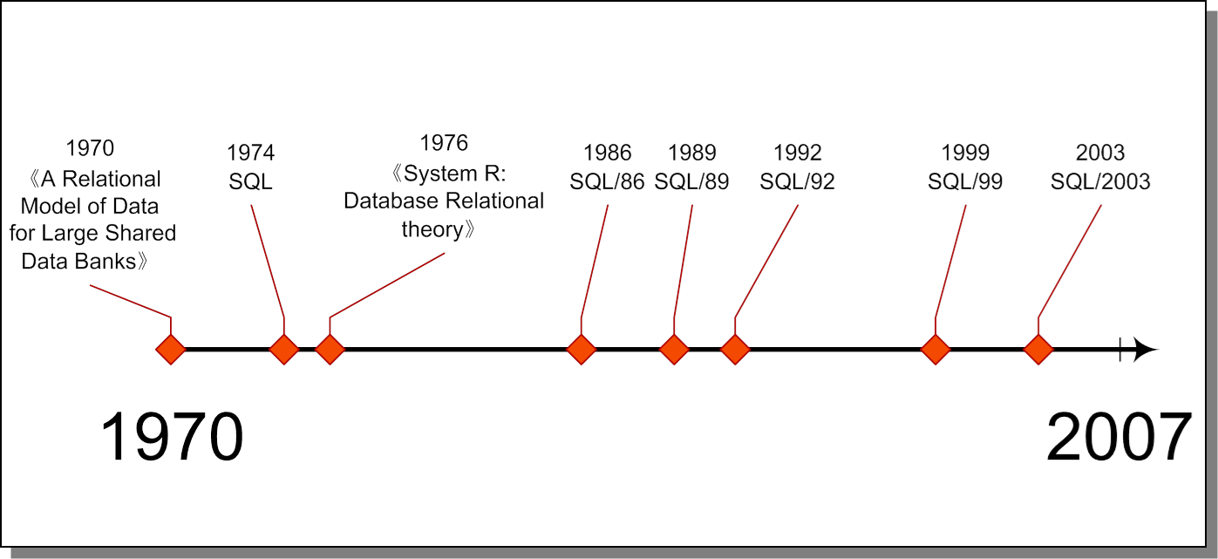
3.1 Overview of the SQL Query Language
The newest SQL standard is SQL/2008

Slide 4
3.1 Overview of the SQL Query Language
History
IBM Sequel language developed as part of System R project at the IBM San Jose Research Laboratory
Renamed Structured Query Language (SQL)
ANSI and ISO standard SQL:
SQL-86, SQL-89, SQL-92
SQL:1999, SQL:2003, SQL:2008
Commercial systems offer most, if not all, SQL-92 features, plus varying feature sets from later standards and special proprietary features.
Not all examples here may work on your particular system.

Slide 5
3.1 Overview of the SQL Query Language
SQL
Structured Query Language
on the basis of the relational algebra and the tuple relational calculus
first implemented in System R by IBM in 1970s
standardized by ANSI and ISO, SQL-86, SQL-89, SQL- 92, SQL-99, OO-SQL, the most recent version is SQL-2003?
widely used for commercial DBS

Slide 6
3.1 Overview of the SQL Query Language
SQL特点
综合统一
SQL语言集数据查询（data query）、数据操纵（data manipulation）、数据定义（data definition）和数据控制（data control）功能于一体，充分体现了关系数据语言的特点和优点
高度非过程化
SQL:做什么（What to do)。减轻了用户负担，而且有利于提高数据的独立性
面向集合的操作方式.
SQL:不仅查找结果可以是元组的集合，而且一次插入、删除、更新操作的对象也可以是元组的集合
语言简洁，易学易用

Slide 7
3.1 Overview of the SQL Query Language
Parts/functions of SQL
data definition language (DDL)
define, delete, modify on schemas, views and index
interactive data-manipulation language (DML)
query/retrieve, insert , delete, update on tuples in DB
data control(DCL)
integrity constraints specifying
authorization: security control, specifying access rights
transaction management
embedded and dynamic SQL

Slide 8
3.1 Overview of the SQL Query Language
9 basic operators in SQL
data manipulation | Select (on relations)
 | Insert, Delete, Update (on relations)
data definition | Create, Drop, Alter (on schema)
data control | Grant, Revoke (in Chapter 4)

Slide 9
3.2 SQL Data Definition
The SQL data-definition language (DDL) allows the specification of information about relations, including:
The schema for each relation.
The domain of values associated with each attribute.
Integrity constraints
And as we will see later, also other information such as
The set of indices to be maintained for each relations.
Security and authorization information for each relation.
The physical storage structure of each relation on disk.

Slide 10
3.2.1 Basic Types
char(n). Fixed length character string, with user-specified length n.
varchar(n). Variable length character strings, with user-specified maximum length n.
int. Integer (a finite subset of the integers that is machine-dependent).
smallint. Small integer (a machine-dependent subset of the integer domain type).
numeric(p,d). Fixed point number, with user-specified precision of p digits, with n digits to the right of decimal point.
real, double precision. Floating point and double-precision floating point numbers, with machine-dependent precision.
float(n). Floating point number, with user-specified precision of at least n digits.
More are covered in Chapter 4.

Slide 11
3.2.2 Basic Schema Definition
An SQL relation is defined using the create table command:
create table r (A₁ D₁, A₂ D₂, ..., A_{n} D_{n}, (integrity-constraint₁), ..., (integrity-constraint_{k}))
r is the name of the relation
each A_{i} is an attribute name in the schema of relation r
D_{i} is the data type of values in the domain of attribute A_{i}
Example:
create table instructor ( ID char(5), name varchar(20) not null, dept_name varchar(20), salary numeric(8,2))
insert into instructor values (‘10211’, ’Smith’, ’Biology’, 66000);
insert into instructor values (‘10211’, null, ’Biology’, 66000);

Slide 12
Integrity Constraints in Create Table
用途：避免数据出现不一致性
Consider five types of integrity constraints:
required data 要求有的数据(not null)
domain constraints 域约束
entity integrity 实体完整性
referential integrity 引用完整性
general constraints 企业约束

Slide 13
Domain Constraints 域约束
CHECK子句直接定义：CHECK (searchConditon)
start_hr numeric(2) check (start_hr >= 0 and
start_hr < 24) (time_solt)
CREATE DOMAIN DomainName [AS] dataType :
CREATE DOMAIN sexType as CHAR
DEFAULT ’M’
CHECK (VALUE IN (‘M’, ‘F’));
Sex SexType NOT NULL

Slide 14
Domain Constraints Tuple-Based CHECK Constraints
Example: For each order form, require auditdate(审核日期) not earlier than signdate in salesorder(orderno, signdate, auditdate, empid, cusid).
CREATE TABLE salesorder
(
orderno int PRIMARY KEY,
signdate datetime NOT NULL DEFAULT getdate(),
auditdate datetime,
empid char(5) NOT NULL,
custid char(4) NOT NULL,
CHECK (auditdate >= signdate)
) ;

Slide 15
Entity Integrity 实体完整性
Primary key of a table must contain a unique,non-null value for each row.
定义主关键字的方法:
定义单主关键字: primary key (dept_name)
定义组合关键字: primary key (time_slot_id, day, start_hr, start_min)
Can still ensure uniqueness for alternate keysusing UNIQUE: 还可以保证关键字唯一性.
building varchar(15),
room_number varchar(7),
UNIQUE (building, room_number)

Slide 16
Entity Integrity 实体完整性
The distinguish and relationship between Primary Key and Unique.
Any two tuples in the relation cannot agree on all of the attributes of Primary Key or Unique attributes set.
Any attempt to violate the rule is rejected by the system.
A table has and only has one Primary Key, while it may has any number of Unique declarations.
An Unique attribute can be NULL.
Attributes in Primary Key are not allowed to have NULL.

Slide 17
Referential Integrity 引用完整性
FK is column or set of columns that links each row in child table containing foreign FK to row of parent table containing matching PK.
Referential integrity means that, if FK contains a value, that value must refer to existing row in parent table.
Any INSERT/UPDATE attempting to create FK value in child table without matching CK value in parent is rejected. 在子表创建和主表候选关键字不匹配的外部关键字：拒绝操作
删除中的问题：Action taken attempting to update/delete a CK value in parent table with matching rows in child is dependent on referential action specified using ON UPDATE and ON DELETE subclauses:在父表中更新或删除和子表有匹配行的候选关键字，有四种操作方式：
a）CASCADE b）SET NULL
c）SET DEFAULT d）NO ACTION

Slide 18
Referential Integrity 引用完整性
CASCADE: Delete row from parent and Delete matching rows in child, and so on in cascading manner.
foreign key (course_id) references course on delete cascade(section)
SET NULL: Delete row from parent and set FK column(s) in child to NULL. Invalidate if FK columns are NOT NULL.
foreign key (dept_name) references department on delete set null(course)
SET DEFAULT: Delete row from parent and set each component of FK in child to specified default. Only valid if DEFAULT specified for FK columns.
NO ACTION: Reject delete from parent.Default.

Slide 19
Integrity Constraints in Create Table
not null(required data)
primary key (A₁, ..., A_{n} )
foreign key (A_{m}, ..., A_{n} ) references r
Example: Declare dept_name as the primary key for department
.
create table instructor ( ID char(5), name varchar(20) not null, dept_name varchar(20), salary numeric(8,2), primary key (ID), foreign key (dept_name) references department)
primary key declaration on an attribute automatically ensures not null
Every Relation Table Can only have one PRIMARY KEY clause .

Slide 20
And a Few More Relation Definitions
create table student ( ID varchar(5), name varchar(20) not null, dept_name varchar(20), tot_cred numeric(3,0), primary key (ID), foreign key (dept_name) references department) );
create table takes ( ID varchar(5), course_id varchar(8), sec_id varchar(8), semester varchar(6), year numeric(4,0), grade varchar(2), primary key (ID, course_id, sec_id, semester, year), foreign key (ID) references student, foreign key (course_id, sec_id, semester, year) references section );
Note: sec_id can be dropped from primary key above, to ensure a student cannot be registered for two sections of the same course in the same semester

Slide 21
And more still
create table course ( course_id varchar(8) primary key, title varchar(50), dept_name varchar(20), credits numeric(2,0), foreign key (dept_name) references department) );
Primary key declaration can be combined with attribute declaration as shown above

Slide 22
3.2.2 Creating Tables
More about create tables
After create table statement executed, the defination will been stored in Data Dictionary as metadata.
A foreign key specification is accepted only if it references an existing table.
There are more complexed integrity Constrants will be introduced later.
Only after tables been created, data can be entered into the table in database.
Integrity Constrants are important part of table to avoid invalid data into database.

Slide 23
参考材料：电商订单主键订单号
从用户体验和数据库优化的角度来看
1.利用数据库主键值产生一个自增长的订单号（订单号即数据表的主键）
2.日期+自增长数字的订单号（比如：2012040110235662）
3.产生随机的订单号(65865325365966)
4.字母+数字字符串式，字母有包含特别意义，C023566525.订单号无重复性；
6.如果方便客服的话，最好是“日期+自增数”样式的订单号，客服一看便知道订单是否在退货保障期限内
7.订单号长度尽量保持短（10位以内），方便用户，尤其电话投诉时，长的号码报错几率高，影响客服效率；
8.订单号尽量保持数字型(纯整数)，在数据库订单索引查询中，长整数字型的数据索引与检索效率，远远高于文本型，因此尽量避免“字母+数字字符串式”！

Slide 24
Drop Table
drop table tablename [ RESTRICT | CASCADE ]
With the CASCADE option, the table and all references to it are removed.(级联 ,有对象,一起删)
With the RESTRICT option, the table is removed if it is not referenced. 默认(受限 有对象，不能删)
example
Drop table student cascade;
Drop table student restrict;

Slide 25
Alter Table Constructs
Alter Table： is used to add attributes or constraints to an existing relation.
Syntax:
ALTER TABLE < table_name > ADD|DROP|ALTER …;
ALTER TABLE tableName
[ADD [COLUMN] columnName dataType [NOT NULL]
[UNIQUE]
[DEFAULT defaultOption] [CHECK (searchCondition)]]
[DROP [COLUMN] columnName [ RESTRICT | CASCADE ]]
[ADD [CONSTRAINT
[constraintName]]tableConstraintDefinition]
[DROP CONSTRAINT constraintName [ RESTRICT | CASCADE ]]
[ALTER [COLUMN] SET DEFAULT defaultOption]
[ALTER [COLUMN] DROP DEFAULT]

Slide 26
Alter Table Constructs
alter table
alter table r add A D
where A is the name of the attribute to be added to relation r and D is the domain of A.
All tuples in the relation are assigned null as the value for the new attribute.
alter table r drop A
where A is the name of an attribute of relation r
Dropping of attributes not supported by many databases

Slide 27
Modifying a Table Schema 2
ALTER TABLE table-name ALTER
修改字段数据类型
ALTER TABLE LIBRARIAN
ALTER Salary NUMBER(6,2);
ALTER TABLE LIBRARIAN
ALTER COLUMN Salary TYPE NUMBER(6,2); --postgreSQL
改变字段的缺省值
ALTER TABLE DEPENDENT
ALTER COLUMN kinship DROP DEFAULT;
ALTER TABLE BOOK ALTER COLUMN BorrowerMemNo
SET DEFAULT NULL;
增加一个不能写成表约束的非空约束
ALTER TABLE products ALTER COLUMN product_no SET NOT NULL;

Slide 28
Modifying a Table Schema 3
ALTER TABLE table-name ADD
增加字段
ALTER TABLE products ADD COLUMN description text ;
增加约束
ALTER TABLE products ADD CHECK (name <> '');
ALTER TABLE products
ADD CONSTRAINT some_name UNIQUE (product_no);
ALTER TABLE products ADD FOREIGN KEY (product_group_id) REFERENCES product_groups;
Tianqing Zhang SCU

Slide 29
Modifying a Table Schema 4
ALTER TABLE table-name ADD
增加字段
ALTER TABLE products ADD COLUMN description text ;
增加约束
ALTER TABLE products ADD CHECK (name <> '');
ALTER TABLE products
ADD CONSTRAINT some_name UNIQUE (product_no);
ALTER TABLE products ADD FOREIGN KEY (product_group_id) REFERENCES product_groups;
解决两表相互引用问题!

Slide 30
Modifying a Table Schema 5
ALTER TABLE table-name DROP
删除字段
ALTER TABLE products DROP COLUMN description RESTRICT; --默认受限删除
ALTER TABLE products DROP COLUMN description CASCADE; --CASCADE 授权删除任何依赖该字段的东西
删除约束
ALTER TABLE products DROP CONSTRAINT constraint_name;
ALTER TABLE products ALTER COLUMN product_no DROP NOT NULL;

Slide 31
3.2.2 Schema Definition (cont.)
Q&A
can a table be defined without its primary key?(Yes)
how to define a candidate key in r?
for a table r, can we define more than one primary keys for it ?
for two tables r₁ and r₂, r₁ is defined with a primary key while r₂ without its primary key, can we insert into r₁ or r₂ two completely identical tuples?
Can we declare a table to reference itself?

Slide 32
SQL Data Query
The SQL data-manipulation language (DML) provides the ability to query information, and insert, delete and update tuples
“Query” (查询) could be generalized definition
Define (定义) , retrieve (检索), modify (修改), control (控制) etc. on DB
Define→DDL(create, alter, drop)
Modify→DML(insert, update, delete)
Retrieve→DML(select)
Control→DCL(grant,revoke)

Slide 33
Basic Query Structure
The SQL data-manipulation language (DML) provides the ability to query information, and insert, delete and update tuples
A typical SQL query has the form: select A₁, A₂, ..., A_{n}
from r₁, r₂, ..., r_{m} where P
A_{i} represents an attribute
R_{i} represents a relation
P is a predicate.
The result of an SQL query is a relation.
Notes:
2

Slide 34
§3.3 Basic structure of SQL Queries — Select clause for data query
A typical SQL query has the form select A₁, A₂, ..., A_{n} from r₁, r₂, ..., r_{m} where P
A_{i}s represent attributes
r_{i}s represent relations
P is a predicate
This query is equivalent to the relational algebra expression
∏ _{A1, A2, ..., An}(σ_{P} (r₁ x r₂ x ... x r_{m}))
the result of an SQL query is a relation
query result :
A₁ | A₂ | … | … | A_{n}
* | * | * | * | *
* | * | * | * | *
* | * | * | * | *
* | * | * | * | *
* | * | * | * | *
t₁
t₂
t_{k}

Slide 35
3.3.1 Queries on a Single Relation
The select clause list the attributes desired in the result of a query
corresponds to the projection operation of the relational algebra
Example: find the names of all instructors: select name from instructor
NOTE: SQL names are case insensitive (i.e., you may use upper- or lower-case letters.)
E.g. Name ≡ NAME ≡ name
Some people use upper case wherever we use bold font.
Notes:
3

Slide 36
3.3.1 Queries on a Single Relation(Cont.)
SQL allows duplicates in relations as well as in query results.
To force the elimination of duplicates, insert the keyword distinct after select.
Find the names of all departments with instructor, and remove duplicates
select distinct dept_name from instructor
The keyword all specifies that duplicates not be removed.
select all dept_name from instructor
Notes:
4

Slide 37
3.3.1 Queries on a Single Relation(Cont.)
An asterisk in the select clause denotes “all attributes”
select * from instructor
The select clause can contain arithmetic expressions involving the operation, +, –, ∗, and /, and operating on constants or attributes of tuples.
The query:
select 'No:'+ID+'Name:'+name, salary/12 from instructor
Note: it does not result in any change to the instructor relation.
Notes:
5

Slide 38
3.3.1 Queries on a Single Relation(Cont.)
The where clause specifies conditions that the result must satisfy
Corresponds to the selection predicate of the relational algebra σ_{p}.
To find all instructors in Comp. Sci. dept with salary > 80000 select name from instructor where dept_name = ‘Comp. Sci.' and salary > 80000
Comparison results can be combined using the logical connectives and, or, and not.
Comparisons can be applied to results of arithmetic expressions.
Notes:
6

Slide 39
3.3.2 Queries on Multiple Relations
The from clause lists the relations involved in the query
Corresponds to the Cartesian product operation of the relational algebra.
select name, instructor.dept_name, building
from instructor, department
where
instructor.dept_name= department.dept_name;
Corresponds to the Cartesian product operation of the relational algebra.

Slide 40
3.3.2 Queries on Multiple Relations
The from clause lists the relations involved in the query
Corresponds to the Cartesian product operation of the relational algebra.
Find the Cartesian product instructor X teaches
select ∗ from instructor, department
generates every possible instructor – department pair, with all attributes from both relations
Cartesian product not very useful directly, but useful combined with where-clause condition (selection operation in relational algebra)
Notes:
8

Slide 41
3.3.2 Queries on Multiple Relations
The from clause lists the relations involved in the query
corresponding to the Cartesian product operation of the relational algebra
E.g. !!!find the Cartesian product instructor X department
select * from instructor, department
generates every possible instructor-department pair, with all attributes from both relations
As a simple representation of “natural join”
!!!e.g. corresponds to
select name, instructor.dept_name, building
from instructor, department
where instructor.dept_name= department.dept_name;
instructor department

Slide 42
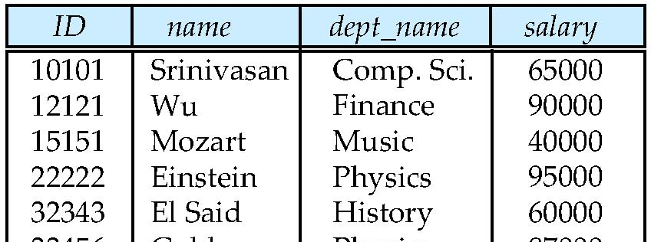
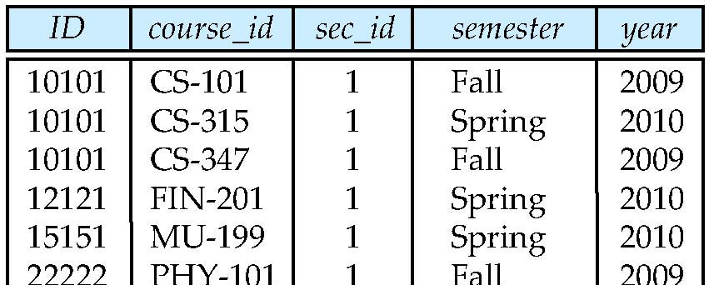
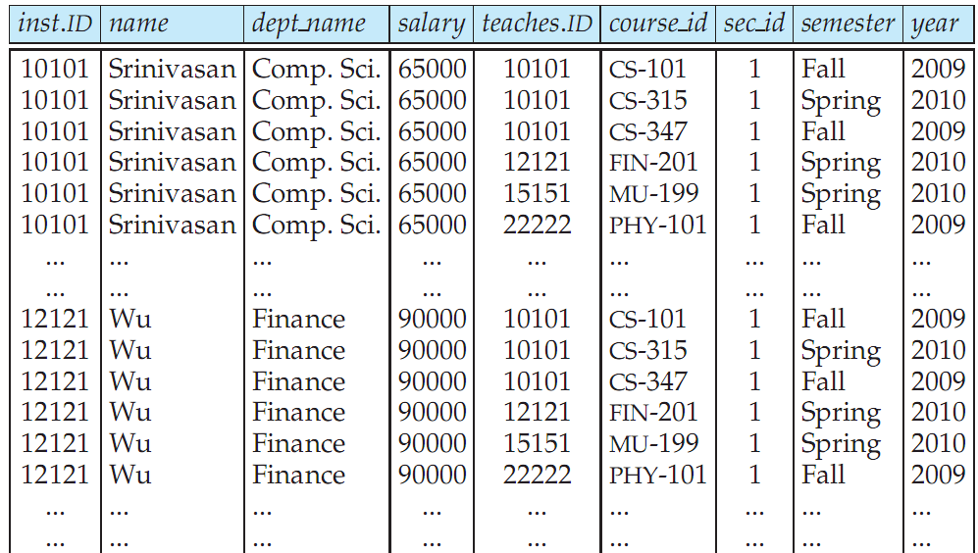
Cartesian Product: instructor X teaches
instructor
teaches

Slide 43
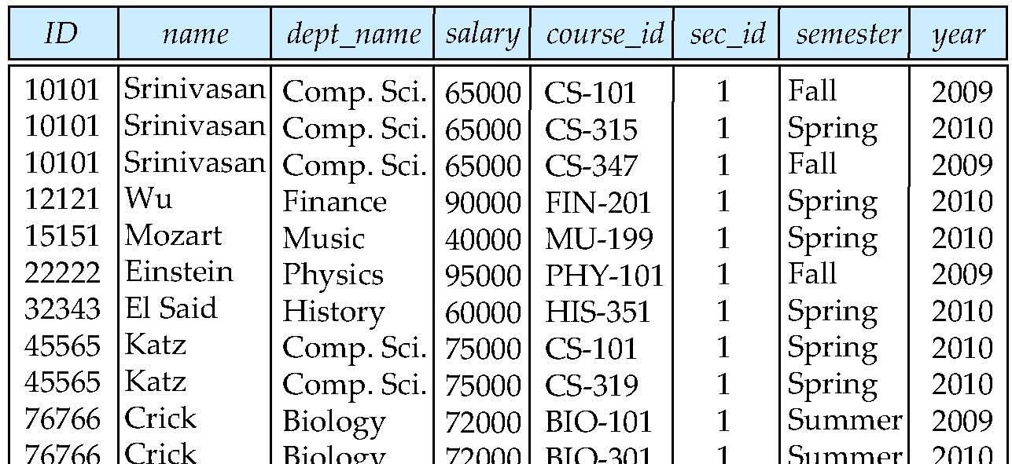
3.3.3 The Natural Join(自然连接）
Natural join matches tuples with the same values for all common attributes, and retains only one copy of each common column 自然连接仅考虑哪些在两个关系模式中都出现的属性上取值相同的元素对，每一个相同属性列仅留一个拷贝。
select * from instructor natural join teaches;

Slide 44
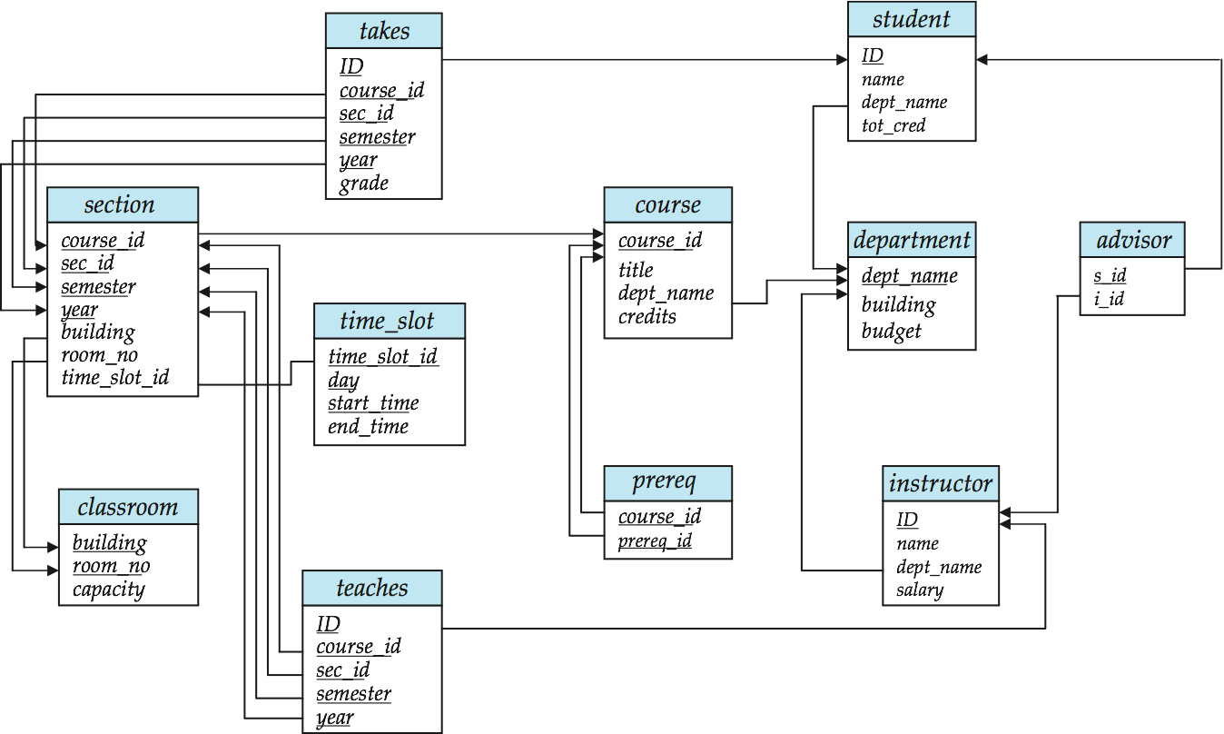
3.3.3 The Natural Joins
For all instructors who have taught some course, find their names and the course ID of the courses they taught.
select name, course_id from instructor, teaches where instructor.ID = teaches.ID
Find the course ID, semester, year and title of each course offered by the Comp. Sci. department
select section.course_id, semester, year, title from section, course where section.course_id = course.course_id and dept_name = ‘Comp. Sci.'

Slide 45
Natural Join Example
List the names of instructors along with the course ID of the courses that they taught.
select name, course_id from instructor, teaches where instructor.ID = teaches.ID;
select name, course_id from instructor natural join teaches;(MySQL)
Danger in natural join: be ware of unrelated attributes with same name which get equated incorrectly.

Slide 46
Natural Join (Cont.)
Danger in natural join: beware of unrelated attributes with same name which get equated incorrectly
List the names of instructors along with the the titles of courses that they teach
Incorrect version (makes course.dept_name = instructor.dept_name)
select name, title from instructor natural join teaches natural join course;
(if a instructor teach a course that not set by the department which the instructor belong to ,the tuple not be found
update course set dept_name='Physics' where course_id='CS-101'; );
Correct version
select name, title from instructor natural join teaches, course where teaches.course_id = course.course_id;
Another correct version
select name, title from (instructor natural join teaches) join course using(course_id);
Note: MS SQL Server doesn’t support keyword “natural join”.
(instructor inner join teaches on instructo.id =teaches.id inner join course on teaches.course_id=course.course_id);

Slide 47
Understanding the Operational Order
Although the clauses must be written in the order select, from, where, the easiest way to understand the operations specified by the query is to consider the clauses in operational order:
first from,
then where,
and then select.

Slide 48
Meaning of an SQL Query
In general, the meaning of an SQL query can be understood as follows:
1. Generate a Cartesian product(笛卡尔积) of the relations listed in the from clause
2. Apply the predicates(谓词) speciﬁed in the where clause on the result of Step 1.
3. For each tuple in the result of Step 2, output the attributes (or results of expressions) speciﬁed in the select clause.

Slide 49
Meaning of an SQL Query
Select *
From R, S
Where R.A = S.B;
is equivalent to:
FOR R = r₁ TO r_{n}
FOR S = s₁ TO s_{m}
IF R.A = S.B
THEN evaluate the attributes of the select
clause and produce the tuples of results

Slide 50
3.4 Additional Basic Operations 3.4.1The Rename Operation
The SQL allows renaming relations and attributes using the as clause:
old-name as new-name
E.g.
select ID, name, salary/12 as monthly_salary from instructor Find the names of all instructors who have a higher salary than some instructor in ‘Comp. Sci’.
select distinct T. name from instructor as T, instructor as S where T.salary > S.salary and S.dept_name = ‘Comp. Sci.’
/*利用T和S区分不同的instructor!, 实现了对同一属性的不同值的比较
Keyword as is optional and may be omitted instructor as T ≡ instructor T
Keyword as must be omitted in Oracle
Notes:
9

Slide 51
3.4.1 The Rename Operation(self-join)
A self-join is joining a table to itself.
Tuple variables are defined in the from clause via the use of the as clause
Find the names of all instructors who have a higher salary than some instructor in ‘Comp. Sci’.
select distinct T. name from instructor as T, instructor as S where T.salary > S.salary and S.dept_name = ‘Comp. Sci.’
Keyword as is optional and may be omitted instructor as T ≡ instructor T
Keyword as must be omitted in Oracle
The key of self-join is the relation renaming operation

Slide 52
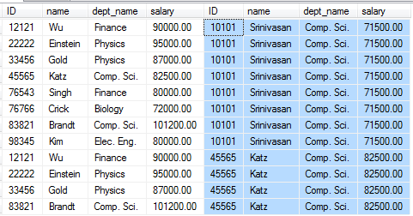
instructor as T
instructor as S
连接条件T.salary > S.salary

Slide 53
3.4.2 String Operations
SQL includes a string-matching operator for comparisons on character strings. The operator “like” uses patterns that are described using two special characters:
percent (%). The % character matches any substring.
underscore (_). The _ character matches any character.
Find the names of all instructors whose name includes the substring “dar”. select name from instructor where name like '%dar%'
Match the string “100 %” like ‘100 \%' escape '\'
Contain the string “100%” like ‘%100 &%%' escape ‘&‘
Note : mysql : not use escape

Slide 54
3.4.2 String Operations
SQL speciﬁes strings by enclosing them in single quotes(单引号), for example, ’Computer’.
A single quote character that is part of a string can be speciﬁed by using two single quote characters; for example, the string “It’s right” can be speciﬁed by “It”s right”
The SQL standard speciﬁes that the equality operation on strings is case sensitive
SQL also permits a variety of functions on character strings, such as concatenating (using “||”), converting strings to uppercase (using upper(s)) and lowercase (using the function lower(s)) and so on.

Slide 55
3.4.2 String Operations (Cont.)
SQL includes a string-matching operator for comparisons on character strings. The operator “like” uses patterns(模式) that are described using two special characters .
percent (%). The % character matches any substring.
/sequence of zero or more characters;
underscore (_). The _ character matches any character.
any single character.

Slide 56
3.4.2 String Operations (Cont.)
Pattern matching examples:
‘Intro%’ matches any string beginning with “Intro”.
‘%Comp%’ matches any string containing “Comp” as a substring.
‘_ _ _’ matches any string of exactly three characters.
‘_ _ _ %’ matches any string of at least three characters.
SQL supports a variety of string operations such as
concatenation (using “||”)
converting from upper to lower case (and vice versa)
finding string length, extracting substrings, etc.

Slide 57
3.4.2 String Operations (Cont.)
New since SQL:2003: regular expression string matching
typically implemented as set of SQL functions, e.g. regexp_like(…)
What are regular expressions?
Pattern consisting of character literals and/or metacharacters
metacharacters specify how to process a regular expression
eg
1、phone number ( 13*********or 15**********)
/ ^1(3|5)[0-9]{9}$/;
2、Email Address（字符数字组合@字符数字组合.字符数字组合）
/^([a-zA-Z0-9])+@([a-zA-Z0-9])+\.([a-zA-Z0-9])+$/;
select name from instructor where regexp_like(email,‘/^([a-zA-Z0-9])+@([a-zA-Z0-9])+\.([a-zA-Z0-9])+$/’)

Slide 58
3.4.3 Attribute Specification in Select Clause
The asterisk symbol “ * ” can be used in the select clause to denote “all attributes.”
select instructor.*
from instructor, teaches
where instructor.ID= teaches.ID;

Slide 59
3.4.4 Ordering the Display of Tuples
The order by clause causes the tuples in the result of query to appear in sorted order, i.e. ascending order or descending order, denoted by keywords asc or desc respectively
ascending order is the default
List in alphabetic order the names of all instructors select distinct name from instructor order by name
We may specify desc for descending order or asc for ascending order, for each attribute; ascending order is the default.
Example: order by name desc
Can sort on multiple attributes
Example: order by dept_name, name

Slide 60
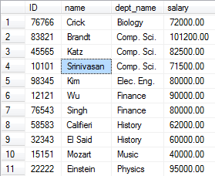
3.4.4 Ordering the Display of Tuples
Order by dept_name,salary desc

Slide 61
3.4.5 Where Clause Predicates
The where clause specifies conditions that the result must satisfy
Comparison operators in SQL: = , > , >= , < , <= , != , <>
Comparison results can be combined using the logical connectives and,or, and not.
Comparisons can be applied to results of arithmetic expressions
Example:
select name from instructor where name like ’wu%’ and dept_name = ‘Comp. Sci.’

Slide 62
3.4.5 Where Clause Predicates
SQL includes a between comparison operator
Example: Find the names of all instructors with salary between $90,000 and $100,000 (that is, ≥ $90,000 and ≤ $100,000)
select name from instructor where salary between 90000 and 100000
Tuple comparison
select name, course_id from instructor, teaches where (instructor.ID, dept_name) = (teaches.ID, ’Biology’);
Note: SQL server doesn‟t support this feature
Notes:
7

Slide 63
3.5 Set Operations
Set operations union, intersect, and except
Each of the above operations automatically eliminates duplicates
to retain all duplicates use the corresponding multiset versions union all, intersect all and except all
(MS SQL Server doesn’t support intersect all and except all)
suppose a tuple occurs m times in r and n times in s, then, it occurs:
m + n times in r union all s
min(m,n) times in r intersect all s
max(0, m – n) times in r except all s(r中减掉r与s的共有元素)

Slide 64
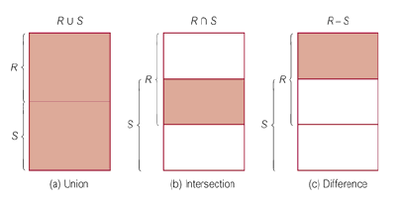
3.5 Set Operations
Set operations union, intersect, and except

Slide 65



3.5 Set Operations
Find courses that ran in Fall 2009 or in Spring 2010
(select course_id from section where semester= ‘Fall’ and year = 2009) union (select course_id from section where semester = ‘Spring’ and year = 2010)

Slide 66


3.5 Set Operations
Find courses that ran in Fall 2009 and in Spring 2010
(select course_id from section where semester = ‘Fall’ and year = 2009) intersect (select course_id from section where semester = ‘Spring’ and year = 2010)
Find courses that ran in Fall 2009 but not in Spring 2010
(select course_id from section where semester = ‘Fall’ and year = 2009) except (select course_id from section where semester = ‘Spring’ and year = 2010)
MySQL ：select course_id from section where semester = 'Fall' and year = 2009 and course_id NOT IN
(select course_id from section where semester = 'Spring' and year = 2010);

Slide 67
3.6 Null Values
It is possible for tuples to have a null value, denoted by null, for some of their attributes
null signifies an unknown value or that a value does not exist.
The result of any arithmetic expression involving null is null
Example: 5 + null returns null
The predicate is null can be used to check for null values.
Example: Find all instructors whose salary is null.
select name from instructor where salary is null (不能用= <>来比较)
select name from instructor where salary =(<>)null;(不会返回结果）

Slide 68
Null Values and Three Valued Logic
Any comparison with null returns unknown
Example: 5 < null or null <> null or null = null
Three-valued logic using the truth value unknown:
OR: (unknown or true) = true, (unknown or false) = unknown (unknown or unknown) = unknown
AND: (true and unknown) = unknown, (false and unknown) = false, (unknown and unknown) = unknown
NOT: (not unknown) = unknown
“P is unknown” evaluates to true if predicate P evaluates to unknown “P is unknown” =T ←→ P = unknown
Result of where clause predicate is treated as false if it evaluates to unknown
把Null换成True和 False，如结果一致，则为其值，否则结果为NUll

Slide 69
Null Values and Three Valued Logic
NULL Three Valued
True
False
Unknown
in genral WHERE clause predicate is true , can be selected
IS NOT FALSE
Example:
SELECT *
FROM instructor
WHERE Salary < 75000;(Salary is NULL not selected)
SELECT *
FROM instructor
WHERE (Salary < 75000) IS NOT FALSE;(Salary is NULL selected)

Slide 70
3.6 Null Values
(not unknown) = unknown
“P is unknown” evaluates to true if predicate P evaluates to unknown
Result of where clause predicate P is treated as false if it evaluates to unknown
Try: select * from instructor where ((null+1) is not null);(NONE false)
select * from instructor where ((null+1) is null);(ALL true)
Null values and aggregates
all aggregate operations except count(*) ignore tuples with null values on the aggregated attributes
SQL Server: isnull() :isnull(field，value) : isnull()函数是用来判断列名是否为null 如果为NUll 则返回value 否则 返回列名的值

Slide 71
3.6 Null Values
Two important rules of operations on Nulls:
When we operate on a NULL and any other value, using an arithmetic operator like ×or ＋, the result is NULL.
When we compare a NULL value and any other value, using an comparison operator like ＝or ＞, the result is UNKNOWN.
Notice that NULL is not a constant, and it can’t be an operand explicitly, such as NULL+3.
SQL conditions, as appear in Where／Having clauses, apply to each tuple, the value can be True, False, or Unknown. Only the tuple for which the condition has the value TRUE become part of the answer.

Slide 72
3.7 Aggregate Functions
Aggregate functions（聚集函数） are functions that take a collection (a set or multiset) of values as input and return a single value.（以集合为输入，返回单个值的函数）
These functions operate on the multiset of values of a column of a relation, and return a value
avg: average value min: minimum value max: maximum value sum: sum of values count: number of values

Slide 73
3.7.1 Basic Aggregation
Find the average salary of instructors in the Computer Science department
select avg (salary) from instructor where dept_name= ’Comp. Sci.’; //ignores tuples with nulls
Find the total number of instructors who teach a course in the Spring 2010 semester
select count (distinct ID) from teaches where semester = ’Spring’ and year = 2010
Find the number of tuples in the course relation
select count (*) from course;
select count (name) from course;
Distinguish between count(*) and count(column). count(*)对所有选出元组计数， count(column)只对column非NULL的元组计数

Slide 74
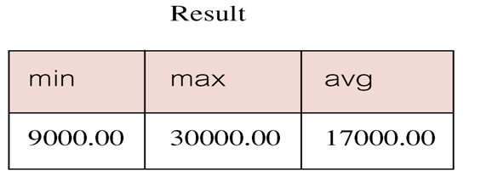
3.7.1 Basic Aggregation
Find minimum, maximum, and average instructor salary.
SELECT MIN(salary) AS min,
MAX(salary) AS max,
AVG(salary) AS avg
FROM instructor;

Slide 75
3.7.2 Aggregation with Grouping
So far, we’ve applied aggregate operators to all (qualifying) tuples. Sometimes, we want to apply them to each of several groups of tuples.
Consider:Find the average salary of instructors in each department
In general we don’t know how many department exist and what the department is?
For dept_name as deptname in department:?
SELECT AVG(salary)
FROM instructor
WHERE dept_name = deptname

Slide 76
3.7.2 Aggregation with Grouping
How to conduct group by subclause and aggregate function
SELECT [DISTINCT] target-list
FROM relation-list
WHERE qualification
GROUP BY grouping-list
HAVING group-qualification
The target-list contains
➢ (i) attribute names or constant
➢ (ii) terms with aggregate operations (e.g., avg(salary)).
The attribute list (i) must be a subset of grouping-list.Intuitively, each answer tuple corresponds to a group,and these attributes must have a single value pergroup. (A group is a set of tuples that have the samevalue for all attributes in grouping-list.)

Slide 77
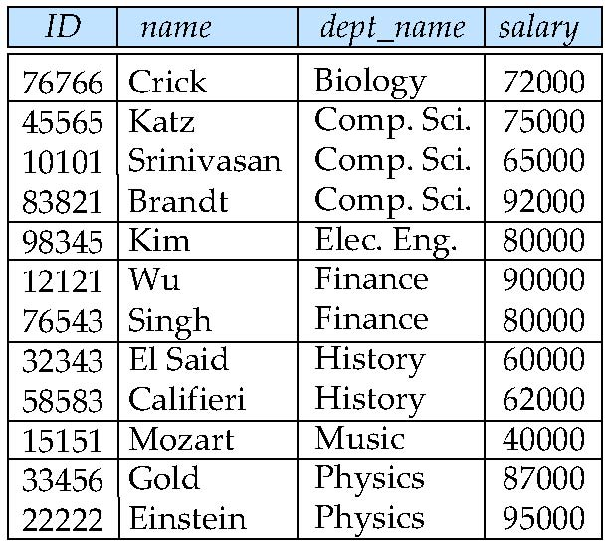
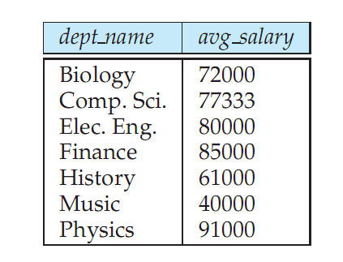
Aggregate Functions – Group By
Find the average salary of instructors in each department
select dept_name, avg (salary) from instructor group by dept_name;
Note: departments with no instructor will not appear in result

Slide 78
Aggregation (Cont.)
Attributes in select clause outside of aggregate functions must appear in group by list (出现在select子句中但没有被聚集的属性必须出现在group by子句中)
/* erroneous query */ select dept_name, ID, avg (salary) from instructor group by dept_name;
（ID is not in group by clause)
(SELECT子句的列名列表中只能出现分组属性和聚集函数,不能出现非聚集的非分组属性)

Slide 79
3.7.3 Having Clause
Try:
“For each course section offered in 2009, find the average total credits (tot_cred) of all students enrolled in the section, if the section had at least 2 students.”
select course_id,semester,year,sec_id,avg(tot_cred)
from takes natural join student
where year=2009
group by course_id,semester,year,sec_id
having count(ID)>2;
Note: SQL server: takes natural join student=>
takes inner join student on takes.id=student.id

Slide 80
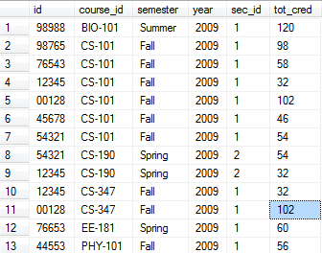
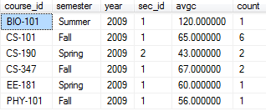
Step 1:select course_id,semester,year,sec_id ,tot_cred from takes inner join student on takes.id=student.id where year=2009 order by course_id,semester,year,sec_id
Step 2: select course_id,semester,year,sec_id,avg(tot_cred) as avgc, count(takes.ID) as count from takes inner join student on takes.id=student.id where year=2009
group by course_id,semester,year,sec_id
Step 3: having count(takes.ID)>2;

Slide 81
3.7.3 Having Clause
HAVING clause is designed for use with GROUP BY to restrict groups that appear in final result table
和WHERE的区别
WHERE选一行
HAVING选一组
Column names in HAVING clause must also appear in the GROUP BY list or be contained within an aggregate function.

Slide 82
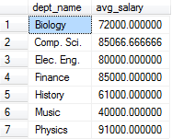
Aggregate Functions – Having Clause
Find the names and average salaries of all departments whose average salary is greater than 42000(平均工资>42000的系)
select dept_name, avg (salary)
from instructor
group by dept_name
having avg (salary) > 42000;
//having salary> 42000;(error why?)
This query requires restriction on tuple groups rather than tuples, so the where clause is useless in the case. Instead, having clause should be used to filter(过滤) tuple groups.
Note: predicates in the having clause are applied after the formation of groups whereas predicates in the where clause are applied before forming groups(用在having中的谓词在形成分组后才起作用，而where子句中的谓词在分组前起作用,理解该语句的执行过程)

Slide 83
Aggregate Functions – Having Clause
Restricting Groupings(HAVING)用HAVING筛选组
HAVING clause is used to restrict groups that appear in result table (HAVING用来筛选出现在结果表中的组).
Similar to WHERE, but WHERE filters rows, whereas HAVING filters groups.
Columns in HAVING clause must also appear in the GROUP BY list or be contained within an aggregate function (和SELECT子句类似，HAVING子句中的列要么在GROUP BY 中，要么在聚集函数中).

Slide 84
3.7.2 Aggregation with Grouping
How to conduct group by subclause and aggregate function
Select A₁, A₂, ., ag_fun(A_{i}),.., A_{j} , .., A_{k},…, A_{n}
From r₁, r₂, ..., r_{m}
Where P1
Group by A_{j}
having P2
notes:
P1 is defined on all attributes of r₁, r₂, ..., r_{m}
A_{j} must be listed in select subclause
P2 is defined on A₁, A₂, ., A_{i},.., A_{j} ,… , A_{k}, …, A_{n}, as the constraints on the group formed by Group by A_{j}, so ag_fun (A_{k}) appear in P2

Slide 85
Aggregate Functions – Group By
FROM → WHERE → GROUP BY → HAVING →SELECT → ORDER BY.
step1. temporal relation T1 is derived from
Select A₁, A₂,…., A_{i},..., A_{j} , .., A_{k},…, A_{n}
From r₁, r₂, ..., r_{m}
Where P1
step2. T1 is grouped on A_{j} , resulting in temporal relation T2
step3.
if having subclause exists,
then the group, which is not in accordance with P2, is
filtered out of T2
step4
Select A₁, A₂, ., ag_fun(A_{i}),.., A_{j} , .., A_{k},…, A_{n}
From T2

Slide 86
3.8 Nested Subqueries
SQL provides a mechanism for the nesting of subqueries, to implement more complex query
A subquery is a select-from-where expression that is nested within another query.
the subquery is often nested in the where clause, and the having clause of another query
A common use of subqueries is to perform tests for set membership, set comparisons, and set cardinality.(子查询通常被用来对集合成员资格、集合的比较以及集合的基数进行检查)
嵌套子查询的执行不依赖与外部的查询。执行过程：
（1）执行子查询，其结果不被显示，而是传递给外部查询，作为外部查询的条件使用。
（2）执行外部查询，并显示整个结果。

Slide 87
3.7.4 Null Values and Aggregates
Total all salaries
select sum (salary ) from instructor
Above statement ignores null amounts
Result is null if there is no non-null amount
All aggregate operations except count(*) ignore tuples with null values on the aggregated attributes
What if collection has only null values?
count returns 0
all other aggregates return null

Slide 88
3.8.1 Set Membership
Using in or not in connective to test membership or absence membership in where clause
SQL allows testing tuples for membership in a relation. The in connective tests for set membership, where the set is a collection of values produced by a select clause. The not in connective tests for the absence of set membership. (SQL允许测试元组在关系中的成员资格。连接词in测试元组是否是集合中的成员，集合是由select子句产生的一组值构成的。连接词not in则测试元组是否不是集合中的成员)

Slide 89
3.8.1 Set Membership
The IN and NOT IN operators check for simple membership.
Example：List each id,name of instructor, except those of the Computer Science, Music, and Physics department.
SELECT id,Name
FROM instructor
WHERE dept_name NOT IN (‘Comp.Sci.', ‘Music’, ‘Physics');
思考：如果dept_name为NULL，情况怎样？(not )

Slide 90
3.8.1 Set Membership
IS NOT FALSE:
SELECT id,Name ,dept_name
FROM instructor
WHERE (dept_name NOT IN (‘Comp.Sci.', ‘Music’, ‘Physics'))
IS NOT FALSE; - -允许Name可以为NULL
IS TRUE:
SELECT id,Name ,dept_name
FROM instructor
WHERE (dept_name NOT IN (‘Comp.Sci.', ‘Music’, ‘Physics'))
IS TRUE; - -明确Name不允许NULL，可省略

Slide 91
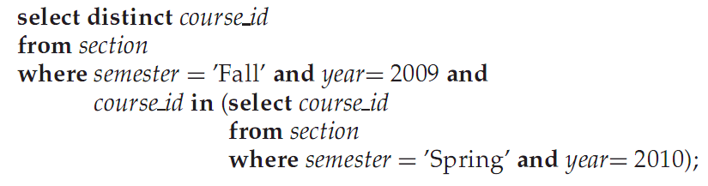
Set Membership
“Find all the courses taught in the both the Fall 2009 and Spring 2010 semesters.”
Step 1 (select course id from section where semester = ’Spring’ and year= 2010)
Step 2

Slide 92
Example Query(SubQueries)
Find courses offered in Fall 2009 and in Spring 2010
select distinct course_id --outer select
from section
where semester = ’Fall’ and year= 2009 and course_id in (select course_id --subselect (innner)
from section
where semester = ’Spring’ and year= 2010);
Find courses offered in Fall 2009 but not in Spring 2010
select distinct course_id
from section
where semester = ’Fall’ and year= 2009 and course_id not in (select course_id
from section
where semester = ’Spring’ and year= 2010);

Slide 93
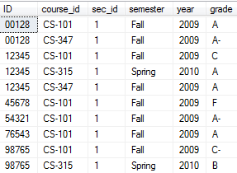
Example Query
Find the total number of (distinct) students who have taken course sections taught by the instructor with ID 10101
select count (distinct ID)
from takes
where (course_id, sec_id, semester, year) in (select course_id, sec_id, semester, year
from teaches
where teaches.ID= 10101);
// (course_id+sec_id+semester+convert(varchar(4),year))
Note: Above query can be written in a much simpler manner. The formulation above is simply to illustrate SQL features.
SQL Server not support mutiplue column sub Query

Slide 94
Set Comparison
Recall: Find names of instructors with salary greater than that of some (at least one) instructor in the Biology department.(至少比一个还高）
select distinct T.name
from instructor as T, instructor as S
where T.salary > S.salary and S.dept_name = ’Biology’;
Same query using > some clause
select name
from instructor
where salary > some (select salary
from instructor
where dept_name = ’Biology’);

Slide 95
Set Comparison
When subquery returns multiple rows with single column, we use <exp> θ {ANY | ALL} (subquery) to express the query condition, which means:
>ANY 大于子查询结果中的某个值(e>s1 OR e>s2 … )
<ANY 小于子查询结果中的某个值 (e<s1 OR e<s2 … )
>=ANY 大于等于子查询结果中的某个值 (e≥s1 OR e≥s2 … )
<=ANY 小于等于子查询结果中的某个值 (e≤s1 OR e≤s2 … )
=ANY 等于子查询结果中的某个值(e=s1 OR e=s2 … ) IN
!=ANY或<>ANY 不等于子查询结果中的某个值(e≠s1 OR e≠s2…无意义)
>ALL 大于子查询结果中的所有值 (e>s1 AND e>s2 … ) >MAX
<ALL 小于子查询结果中的所有值值 (e<s1 AND e<s2 … ) <MIN
>=ALL 大于等于子查询结果中的所有值 (e≥s1 AND e≥s2 … ) >=MAX
<=ALL 小于等于子查询结果中的所有值 (e≤s1 AND e≤s2 … ) <=MIN
=ALL 等于子查询结果中的所有值(e=s1 AND e=s2 … 无意义)
!=ALL或<>ALL 不等于子查询结果中的任何一个值 (e≠s1 AND e≠s2…)
NOT IN
SOME may be used in place of ANY.

Slide 96
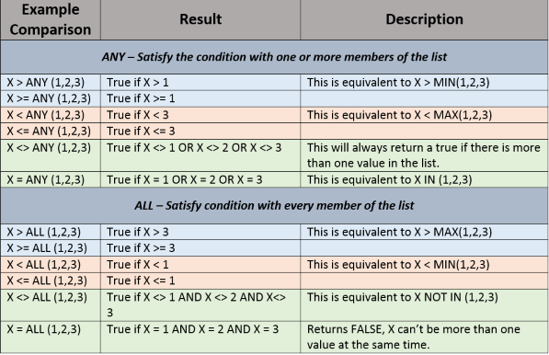
Set Comparison

Slide 97
Definition of Some Clause
F <comp> some r ⇔ ∃ t ∈ r such that (F <comp> t ) Where <comp> can be: <, ≤, >, =, ≠
0
(5 < some
5
) = true
(read: 5 < some tuple in the relation)
6
0
(5 < some
5
) = false
0
(5 = some
) = true
5
0
(5 ≠ some
5
) = true (since 0 ≠ 5)
(= some) ≡ in
However, (≠ some) ≡ not in

Slide 98
Example Query
Find the names of all instructors whose salary is greater than the salary of all instructors in the Biology department.（比所有的还高,最大）
select name
from instructor
where salary > all (select salary
from instructor
where dept_name = ’Comp. Sci.’);
(salaries of insatructor in Comp.Sci from instructor 65000,75000,92000)
where salary > select max(salary) from ……
Note : 类似的找最高成绩、最多数量均可采用 >all
select name
from instructor
where salary <= all (select salary from instructor);
What’s mean? ( min(salary) )

Slide 99
Example Query
Find the names of all instructors whose salary is the highest.
select name
from instructor
where salary = (select max(salary)
from instructor));
Find the names of all instructors whose salary is the above their average salary
select name
from instructor
where salary > (select avg(salary)
from instructor));

Slide 100
Definition of all Clause
F <comp> all r ⇔ ∀ t ∈ r (F <comp> t)
0
(5 < all
5
) = false
6
6
(5 < all
) = true
10
4
(5 = all
) = false
5
4
(5 ≠ all
) = true (since 5 ≠ 4 and 5 ≠ 6)
6
(≠ all) ≡ not in
However, (= all) ≡ in

Slide 101
Test for Empty Relations
SQL uses exists, not exists and except constructs to test whether or not a subquery (, which is a set of tuples) is nonempty or not respectively,
The exists construct returns the value true if the argument subquery is nonempty.
exists r ⇔ r ≠ Ø
not exists r ⇔ r = Ø
except: X – Y
X – Y = Ø ⇔ X ⊆ Y
集合包含，X ⊆ Y ⇔ ( X – Y ) = Ø ⇔ not exists ( X except Y )

Slide 102
Exists and Not Exists
Format: [ NOT ] EXISTS (subquery)
Result: true or false.
Meaning:
EXISTS (subquery):
True if subquery returns a non-empty result table.
False if subquery returns an empty result table.
NOT EXISTS (subquery): the opposite of EXISTS
True if subquery returns an empty result table.
False if subquery returns a non-empty result table.
Property:
As [NOT] EXISTS check only for existence or non-existence of rows in subquery result table,
subquery can contain any number of columns.
Commonly, subqueries following [NOT] EXISTS is of form: ( SELECT * ... )

Slide 103
Exists and Not Exists
Find all students who do not take course ‘CS-101’
1.select * from student where ID not in (select ID from takes where course_id='CS-101');
2.select * from student S where not exists (select * from takes T where S.ID=T.ID and T.course_id='CS-101');
select id from takes where course_id<>'CS-101'; X

Slide 104
Correlated Subquery
A subquery that uses a correlation name from an outer query is called a correlated subquery（内层查询的关系名用到了外层查询的关系名）
The result of the subquery is NOT constant
Varies as the record pointer moves in the table of the parent query
Observe and explain the following query:
Find the students who takes more than 2 couses; SELECT column1, column2, ...
FROM table1 outer
WHERE column1 operator
(SELECT colum1, column2
FROM table2
WHERE expr1 = outer.expr2);

Slide 105
Correlated Subquery
Find the students who takes more than 2 couses;
select ID,name from student where (
select COUNT(*) from takes where takes.ID=student.ID group by takes.ID)>2;(分析其执行过程)

Slide 106
Correlated Subquery
Correlated subqueries are used for row-by-row
processing. Each subquery is executed once forevery row of the outer query.
GET
candidate row from outer query
EXECUTE
inner query using candidate row value
USE
values from inner query to qualify or disqualify candidate row

Slide 107
Correlation Variables
Yet another way of specifying the query “Find all courses taught in both the Fall 2009 semester and in the Spring 2010 semester”
select course_id from section as S where semester = ’Fall’ and year= 2009 and exists (仅测试查询结果是否存在，不返回结果)
( select * from section as T where semester = ’Spring’ and year= 2010 and S.course_id= T.course_id);
Correlated subquery
Correlation name or correlation variable

Slide 108
Correlated Subquery
In queries that contain subqueries, a scoping rule applies for correlation names.
In a subquery, according to the rule, it is legal to use only correlation names deﬁned in the subquery itself or in any query that contains the subquery.
If a correlation name is deﬁned both locally in a subquery and globally in a containing query, the local deﬁnition applies.

Slide 109
Not Exists
Find all students who have taken all courses offered in the Biology department.
all courses offered in the Biology department.(X)
The student have taken all course;(Y for every student)
X in Y = true ⇔ X – Y = Ø ⇔ X ⊆ Y ⇔not exists(X - Y)
select distinct S.ID, S.name
from student as S
where not exists ( (select course_id
from course
where dept_name = ’Biology’)
except
(select T.course_id
from takes as T
where S.ID = T.ID));
Biology开设的所有课程(X)
某个学生选取的所有课程(Y)
Note that X – Y = Ø ⇔ X ⊆ Y（X中的所有元素全部在Y中）
Note: Cannot write this query using = all and its variants

Slide 110
Not Exists
select distinct S.ID, S.name
from student as S
where not exists
( (select course_id
from course C where dept_name = ’Biology’
and not exists
(select T.course_id
from takes as T
where S.ID = T.ID and
C.course_id=T.course_id ));
Note:用程序循环控制结构的思维方法理解这一过程。
对’Biology’开设的每一门课程
测试该学生是否选了这门课
如果没有选，该学生就不符合条件

Slide 111
Test for Absence of Duplicate Tuples
The unique construct tests whether a subquery has any duplicate tuples in its result.
(Evaluates to “true” on an empty set)
Find all courses that were offered at most once in 2009
select T.course_id from course as T where unique (select R.course_id from section as R where T.course_id= R.course_id and R.year = 2009);
note: not supported by Oracle

Slide 112
Subqueries in the From Clause
SQL allows a subquery expression to be used in the from clause
The key concept applied here is that any select-from-where expression returns a relation as a result and, therefore, can be inserted into another select-from-where anywhere that a relation can appear.

Slide 113
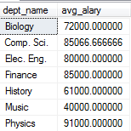
Subqueries in the From Clause
Find the average instructors’ salaries of those departments where the average salary is greater than $42,000.
> select dept_name,avg(salary) from instructor group by dept_name having avg(salary)>42000;
select dept_name, avg_salary from (select dept_name, avg (salary) as avg_salary from instructor group by dept_name) temp where temp.avg_salary > 42000; (MYSQL 支持)
Note that we do not need to use the having clause
Another way to write above query
select dept_name, avg_salary from (select dept_name, avg (salary) from instructor group by dept_name) as dept_avg (dept_name, avg_salary) where avg_salary > 42000; (SQL Server支持)

Slide 114
Subqueries in the From Clause (Cont.)
And yet another way to write it: lateral clause
select name, salary, avg_salary from instructor I1, lateral (select avg(salary) as avg_salary from instructor I2 where I2.dept_name= I1.dept_name);
Lateral clause permits later part of the from clause (after the lateral keyword) to access correlation variables from the earlier part.
Note: lateral is part of the SQL standard, but is not supported on many database systems; some databases such as SQL Server offer alternative syntax

Slide 115
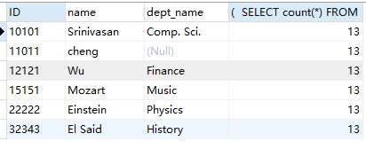
Subqueries in the From Clause
SELECT ID,name,dept_name,
( SELECT count(*) FROM instructor)
FROM instructor;

Slide 116
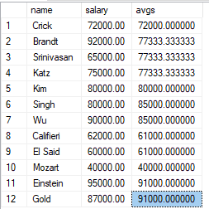
Subqueries in the From Clause
select name,salary,avg(salary) over(PARTITION by dept_name) as avgs from instructor (SQL Server）

Slide 117
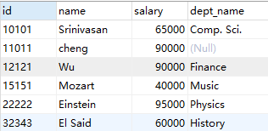
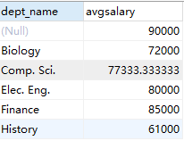
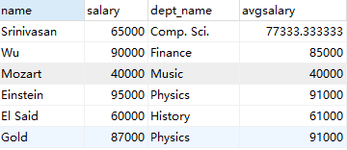
Subqueries in the From Clause
select name,salary,dept_name,avgsalary from (
(select id,name,salary,dept_name from instructor) a natural join ( select dept_name,avg(salary) as avgsalary from instructor group by dept_name) b ); （MYSQL）

Slide 118
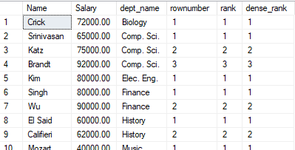
Window Fuctions
select Name, Salary, dept_name,
row_number() over(partition by dept_name order by salary) as rownumber,
rank() over(partition by dept_name order by salary) as rank,
dense_rank() over(partition by dept_name order by salary) as dense_rank
from instructor
order by dept_name,salary

Slide 119
With Clause
The with clause provides a way of defining a temporary view whose definition is available only to the query in which the with clause occurs. (With子句提供了定义临时视图的方法，该定义只对包含with子句的查询有效)
Find all departments with the maximum budget with max_budget (value) as (select max(budget) from department) select budget from department, max_budget where department.budget = max_budget.value;
With clause is very useful for writing complex queries
Supported by most database systems, with minor syntax variations

Slide 120
Complex Queries using With Clause
With clause is very useful for writing complex queries
Supported by most database systems, with minor syntax variations
Find all departments where the total salary is greater than the average of the total salary at all departments
分部门总工资
with dept _total (dept_name, value) as
(select dept_name, sum(salary)
from instructor
group by dept_name),
dept_total_avg(value) as
(select avg(value)
from dept_total)
select dept_name
from dept_total, dept_total_avg
where dept_total.value >= dept_total_avg.value;
分部门平均工资

Slide 121
Scalar Subquery
Scalar subquery is one which is used where a single attibute with a single value is expected.
A scalar subquery expression is a subquery that returns exactly one column value from one row.
E.g. select dept_name, (select count(*) from instructor where department.dept_name = instructor.dept_name) as num_instructors from department;
E.g. select name from instructor where salary * 10 > (select budget from department where department.dept_name = instructor.dept_name)
Single value
Single value

Slide 122
Scalar Subquery
Runtime error if subquery returns more than one result tuple
(如果执行后结果不止一个元组，则产生一个运行时错误)
E.g. select id,name
from instructor where salary=(
select max(salary) from instructor
group by dept_name)
multi value

Slide 123
Some New Features of SQL
CASE Expression
Officers (name, status, rank, title)
SELECT name, CASE status
WHEN 1 THEN ‘Active Duty’
WHEN 2 THEN ‘Reserve’
WHEN 3 THEN ‘Special Assignment’
WHEN 4 THEN ‘Retired’
ELSE ‘Unknown’
END AS status
FROM Officers ;

Slide 124
Some New Features of SQL
select top num tuples
select top num * from table;(Sql Server)
select * from table limit num;(mysql)
select top 2 from instructor order by dept_name;
select * from instructor order by dept_name LIMIT 2;(MySQL）

Slide 125
Some New Features of SQL
CAST Expression
Change the expression to the target data type
Use: CAST (expression AS data_type)
CAST('12' AS int)
CAST(salary AS varchar(10))

Slide 126
Query Summary
A Complete Description of SQL Select—conceptual order
Firstly, the relational product of all tables in the FROM clause is formed.
From this, rows not satisfying the WHERE condition are eliminated.
The remaining rows are grouped in accordance with the GROUP BY clause.
Groups not satisfying the HAVING clause are then eliminated.
The expressions of the SELECT clause select list are evaluated.
If the keyword DISTINCT is present, duplicate rows are now eliminated.
Evaluate UNION, INTERSECT, and EXCEPT for Subqueries up to this point.
Finally, the set of all selected rows is sorted if an ORDER BY is present.

Slide 127
Modification of the Database
Deletion of tuples from a given relation
Insertion of new tuples into a given relation
Updating values in some tuples in a given relation
Subquery can be used in modification of the database

Slide 128
Modification of the Database – Deletion
Delete all instructors
delete from instructor
Delete all instructors from the Finance department delete from instructor where dept_name= ’Finance’;
Delete all tuples in the instructor relation for those instructors associated with a department located in the Watson building.
delete from instructor where dept_name in (select dept_name from department 。 where building = ’Watson’);

Slide 129
Deletion (Cont.)
Delete all instructors whose salary is less than the average salary of instructors
delete from instructor
where salary< (select avg (salary) from instructor);
Problem: as we delete tuples from deposit, the average salary changes(理解其执行的过程)
Solution used in SQL:
1. First, compute avg salary and find all tuples to delete
2. Next, delete all tuples found above (without recomputing avg or retesting the tuples)

Slide 130
Modification of the Database – Insertion
Add a new tuple to course
insert into course values (’CS-437’, ’Database Systems’, ’Comp. Sci.’, 4);
or equivalently insert into course (course_id, title, dept_name, credits) values (’CS-437’, ’Database Systems’, ’Comp. Sci.’, 4);
Add a new tuple to student with tot_creds set to null
insert into student values (’3003’, ’Green’, ’Finance’, null);

Slide 131
Insertion (Cont.)
Add all instructors to the student relation with tot_creds set to 0
insert into student select ID, name, dept_name, 0 from instructor
The select from where statement is evaluated fully before any of its results are inserted into the relation (otherwise queries like insert into table1 select * from table1; would cause problems, if table1 did not have any primary key defined.

Slide 132
Modification of the Database – Updates
Increase salaries of instructors whose salary is over $100,000 by 3%, and all others receive a 5% raise
Write two update statements:
update instructor set salary = salary * 1.03 where salary > 100000; update instructor set salary = salary * 1.05 where salary <= 100000;
The order is important
Can be done better using the case statement (next slide)

Slide 133
Updates
Can you figure out the statement? “all instructors with salary over $100,000 receive a 3 percent raise, whereas all others receive a 5 percent raise.”
Does the following statements works? Write two update statements: update instructor set salary = salary * 1.05 where salary <= 100000; update instructor set salary = salary * 1.03 where salary > 100000;

Slide 134
Updates
update instructor set salary = salary * 1.03 where salary > 100000; update instructor set salary = salary * 1.05 where salary <= 100000;
The order is important!!!
Can be done better using the case statement
SSDUT-Software School of DUT

Slide 135
Case Statement for Conditional Updates
Same query as before but with case statement
“all instructors with salary over $100,000 receive a 3 percent raise, whereas all others receive a 5 percent raise.”
update instructor set salary = case when salary <= 100000 then salary * 1.05 else salary * 1.03 end

Slide 136
Updates with Scalar Subqueries
Recompute and update tot_creds value for all students
update student S set tot_cred = ( select sum(credits) from takes natural join course where S.ID= takes.ID and takes.grade <> ’F’ and takes.grade is not null);
Sets tot_creds to null for students who have not taken any course
Instead of sum(credits), use:
case when sum(credits) is not null then sum(credits) else 0 end
SQL server: isnull(sum(credits),0)

Slide 137
Updates
Recompute and update tot_creds value for all students
update student S set tot_cred = ( select sum(credits) from takes natural join course where S.ID= takes.ID and takes.grade <> ’F’ and takes.grade is not null);
Sets tot_creds to null for students who have not taken any course
Instead of sum(credits), use:
case when sum(credits) is not null
then sum(credits) else 0 end
SQL Server: isnull(sum(credits),0)

Slide 138
Scalar Subqueries
A Scalar subquery is any expression that produces a single value(single tuple /single column);
Examples:
select max(salary) from instructor;
select count(*) from instructor;
Scalar subqueries can be used as if they were “constants”;
In expressions in the where clause;
To output values in the select clause;

Slide 139
Scalar Subqueries
Find the instructor whose salary is higher than average salary :
SELECT * FROM instructor AS i WHERE salary > (SELECT avg(salary) FORM instructor WHERE dept_name=i.dept_name)
List the deptno, deptname, and the max salary of alldepartments located in New York :
SELECT d.deptno, d.deptname, (SELECT MAX (salary) FROM emp WHERE deptno=d.deptno) AS maxpay FROM dept AS d WHERE d.location = ‘New York’ ;

Slide 140
附录： Select 语句的执行过程
SELECT [DISTINCT | ALL] {* | [colExp [AS newName]] [,...] }
FROM TableName [alias] [, ...]
[WHERE condition1]
[GROUP BY colList1] [HAVING condition2]
[ORDER BY colList2]
执行
过程
根据WHERE子句的条件表达式，
从FROM子句的基本表或视图的笛卡儿积中，
找出满足条件的元组，
按SELECT子句的目标列表达式，
进行投影，
形成结果表。
Π ( )
σ ( )
r
×
s
×…
_{X1, X2,…}
_{F}
X₁ | X₂ | …
… | … | …

Slide 141
附录： Select 语句的执行过程
SELECT [DISTINCT | ALL] {* | [colExp [AS newName]] [,...] }
FROM TableName [alias] [, ...]
[WHERE condition1]
[GROUP BY colList1] [HAVING condition2]
[ORDER BY colList2]
执行
过程
如果有GROUP BY子句，则：
先将选择结果σ_{F}(r× s×…)，按<colList1>的值分组(值相等的元组分为一组)
然后将(聚)集函数作用到组，得到一条“记录”，
最后将这条“记录”投影到目标列，产生结果表的一条记录。
如果GROUP BY带HAVING，则只输出满足HAVING条件的组
如果有ORDER BY，则结果表还要按<colList2>的值升序或降序排列。

Slide 142
SELECT [DISTINCT | ALL] {* | [colExp [AS newName]] [,...] }
FROM TableName [alias] [, ...]
[WHERE condition1]
[GROUP BY colList1] [HAVING condition2]
[ORDER BY colList2]
是r.U∪s.U∪…的子集
σ_{F}(r× s×…)
… | r.A_{i} | … | s.A_{j} | …
… | … | … | … | …
… | ai | … | bj | …
… | … | … | … | …
… | ai | … | bj | …
… | … | … | … | …
一个组
将选择结果σ_{F}(r× s×…)，按<列名列表1>的值分组(值相等的元组分为一组)

Slide 143
SELECT [DISTINCT | ALL] {* | [colExp [AS newName]] [,...] }
FROM TableName [alias] [, ...]
[WHERE condition1]
[GROUP BY colList1] [HAVING condition2]
[ORDER BY colList2]
未作用集函数的列
集函数中的列
Group By中的列
σ_{F}(r× s×…)
Sum
… | r.A_{i} | … | s.A_{j} | …
… | … | … | … | …
… | ai | … | bj | …
… | … | … | … | …
… | ai | … | bj | …
… | … | … | … | …
… | r.A_{i} | … | s.A_{j} | …
… | … | … | … | …
… | ai | … | bj | …
 |  |  |  | …
 |  |  |  | …
… | … | … | … | …
作用集函数（Count、Sum、Avg等）
将(聚)集函数作用到每个组的某些列，得到一条“记录”
返回

Slide 144
SELECT [DISTINCT | ALL] {* | [colExp [AS newName]] [,...] }
FROM TableName [alias] [, ...]
[WHERE condition1]
[GROUP BY colList1] [HAVING condition2]
[ORDER BY colList2]
未作用集函数的列
集函数中的列
Group By中的列
要求目标列(即X₁,X₂,…)要么在Group By中，要么在集函数中，否则结果表将违反1NF。
Sum
… | r.A_{i} | … | s.A_{j} | …
… | … | … | … | …
… | ai | … | bj | …
 |  |  |  | …
 |  |  |  | …
… | … | … | … | …
结果表
X₁ | X₂ | …
… | … | …
… | ai | …
… | … | …
将这条“记录”投影到目标列，产生结果表的一条记录
返回

Slide 145
End of Chapter 3

Slide 146
Advanced SQL Features**
Create a table with the same schema as an existing table:
create table temp_account like account

Slide 147
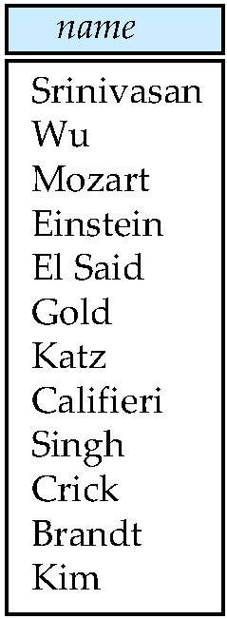
Figure 3.02

Slide 148
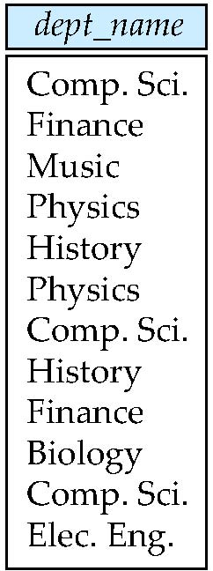
Figure 3.03

Slide 149
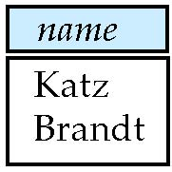
Figure 3.04

Slide 150
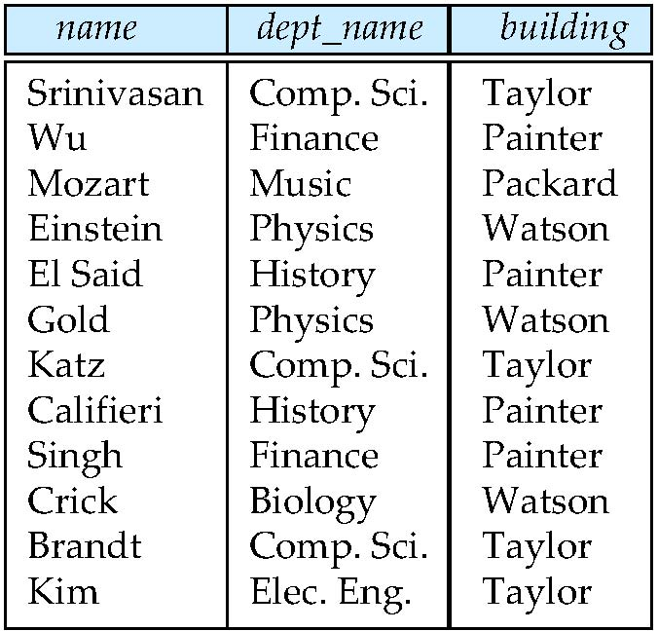
Figure 3.05

Slide 151
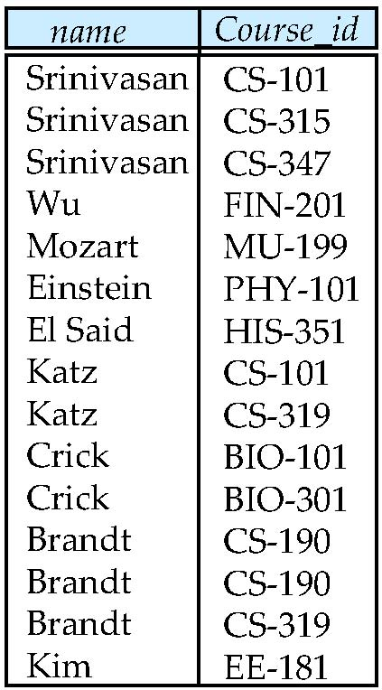
Figure 3.07

Slide 152
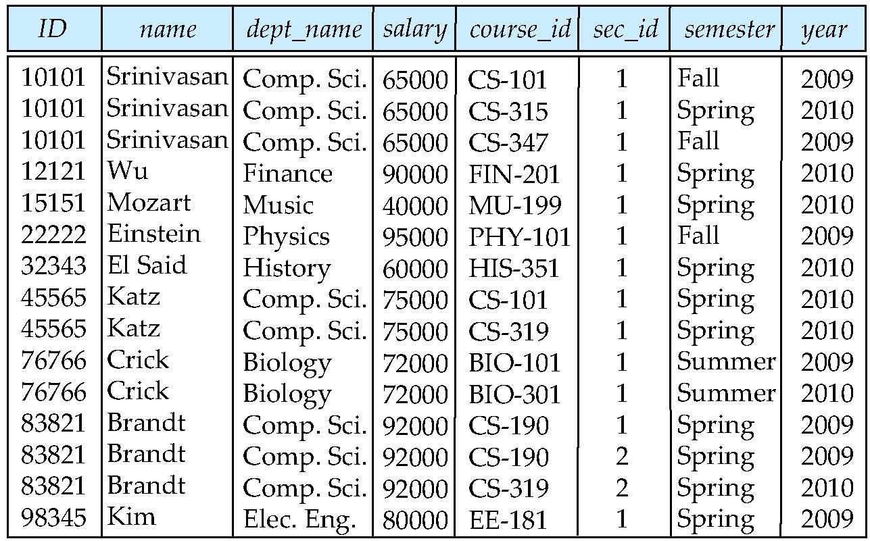
Figure 3.08

Slide 153
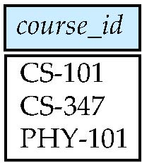
Figure 3.09

Slide 154
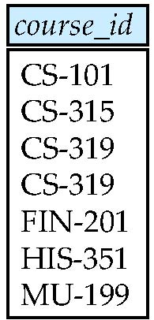
Figure 3.10

Slide 155
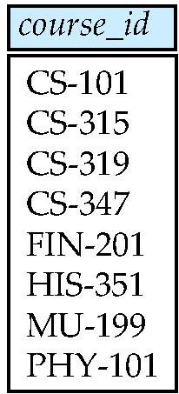
Figure 3.11

Slide 156
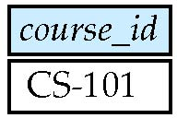
Figure 3.12

Slide 157
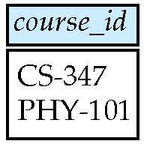
Figure 3.13

Slide 158
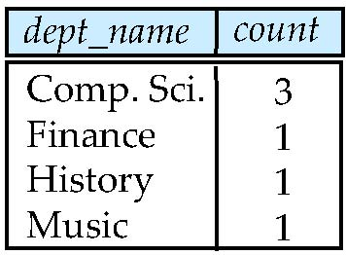
Figure 3.16

Slide 159
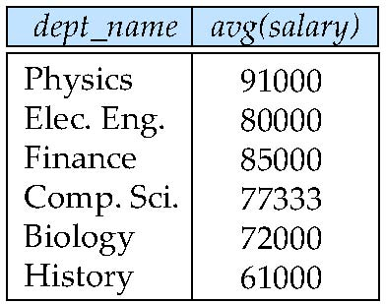
Figure 3.17

